Slide 1

Bank Marketing
virtual internship
Dec-29-2022

Slide 2

Agenda
Background
Path to profit
Idea
Roadmap
Results
Data visualization
Recommendations

Slide 3


Background
Term deposit product
Increae wallet share
ABC
Clients

Slide 4


Path to profit
Know the clients
Satisfy needs of clients
Grow ABC’s future profit (potential)

Slide 5

Idea
How can we apply machine learning on ABC’s internal data to better understand ABC’s clients and support expert advisers.

Slide 6








Roadmap
Data cleaning
EDA
Classification
Evaluation
Duplicates removal
Outlier removal
Undersampling
Feature Engineering
Logistic Regression
SVM
Random Forest
Xgboost
Precision
Recall
F-1 score
Accuracy

Slide 7
Results
 | Data with all features |  |  |  | Data with multicollinearity removal through the heatmap |  |  |  | Data with multicollinearity removal through the VIF function |  |  |  | Data with outlier removal
 | Accuracy | Recall | Precision | F1 | Accuracy | Recall | Precision | F1 | Accuracy | Recall | Precision | F1 | Accuracy | Recall | Precision | F1
LR | 0.8745 | 0.8817 | 0.8674 | 0.8745 | 0.8422 | 0.8622 | 0.8309 | 0.8463 | 0.8517 | 0.8340 | 0.8666 | 0.8500 | 0.8714 | 0.8694 | 08825 | 0.8759
SVM | 0.8784 | 0.9042 | 0.8485 | 0.8755 | 0.8426 | 0.8511 | 0.8389 | 0.8450 | 0.8590 | 0.8143 | 0.8964 | 0.8534 | 0.8746 | 0.8511 | 0.9030 | 0.8763
RF | 0.8793 | 0.8314 | 0.9213 | 0.8741 | 0.8521 | 0.8203 | 0.8782 | 0.8482 | 0.8724 | 0.8179 | 0.9201 | 0.8659 | 0.8841 | 0.8563 | 0.9162 | 0.8852
Xgboost | 0.8840 | 0.8562 | 0.9083 | 0.8815 | 0.8439 | 0.8306 | 0.8555 | 0.8428 | 0.8577 | 0.8203 | 0.8887 | 0.8532 | 0.8827 | 0.8607 | 0.9098 | 0.8846

Slide 8
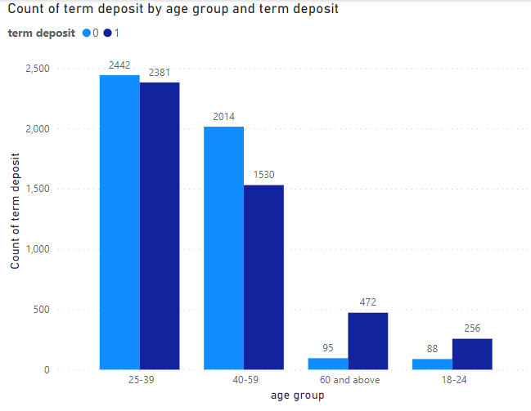
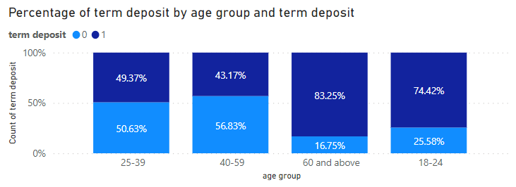
Data visualization

Slide 9
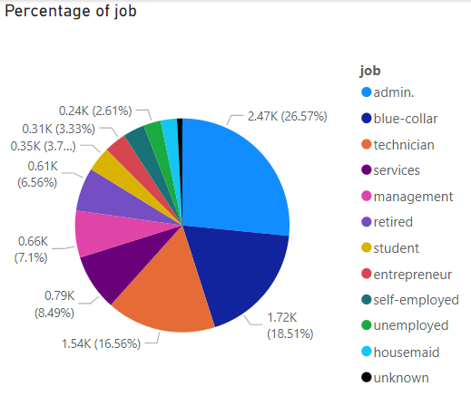
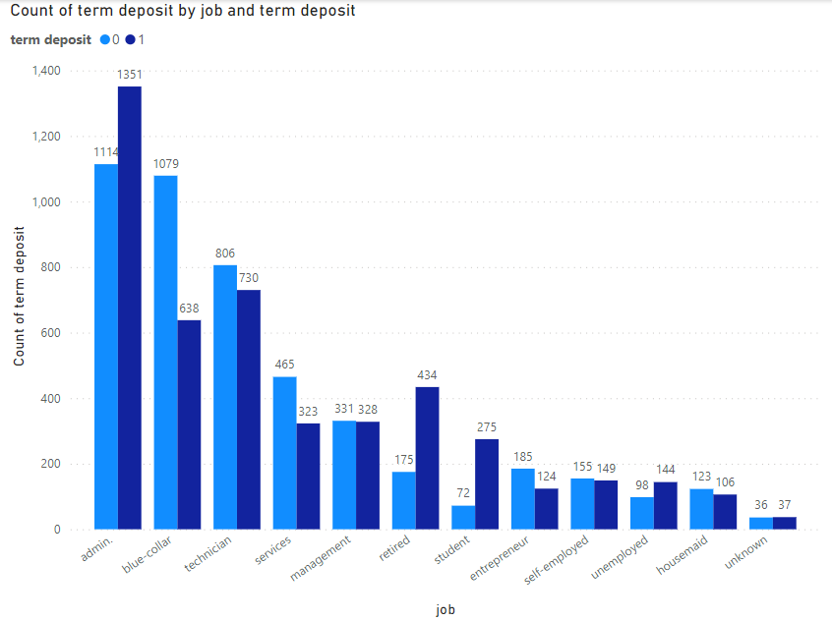
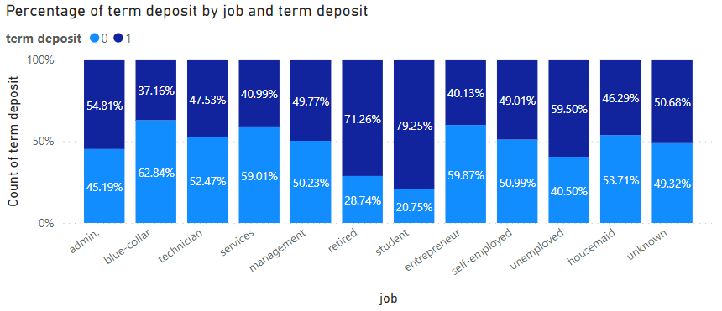
Data visualization

Slide 10
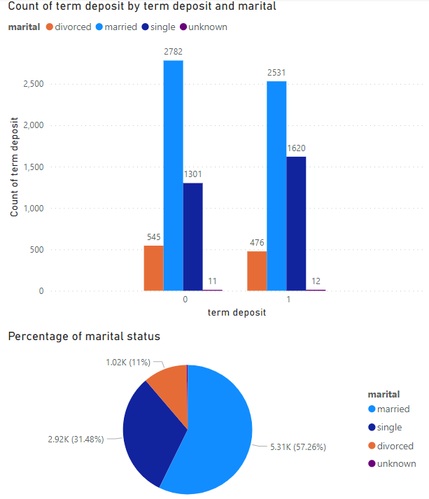
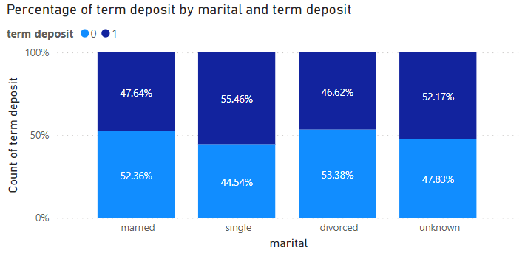
Data visualization

Slide 11
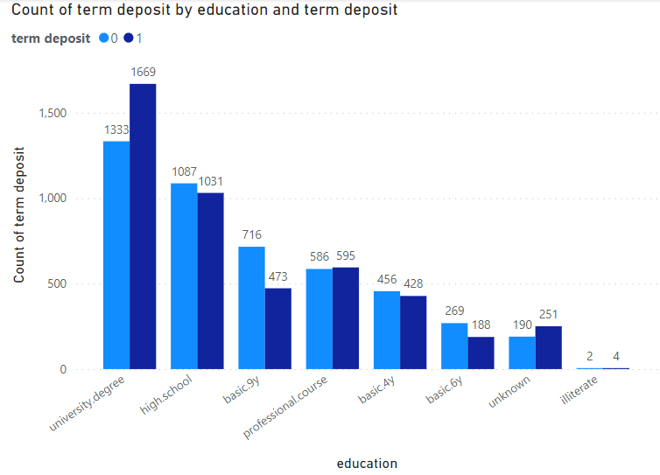
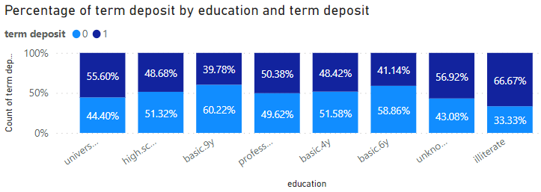
Data visualization

Slide 12
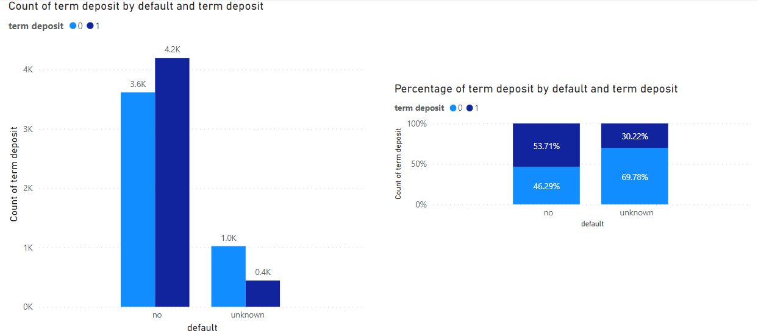
Data visualization

Slide 13
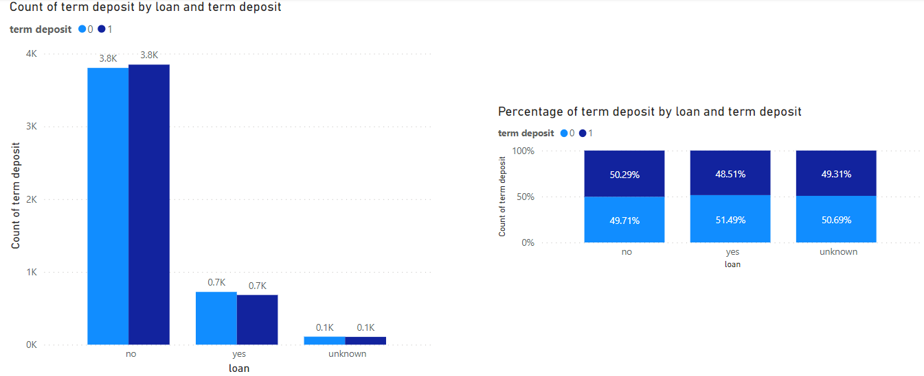
Data visualization

Slide 14
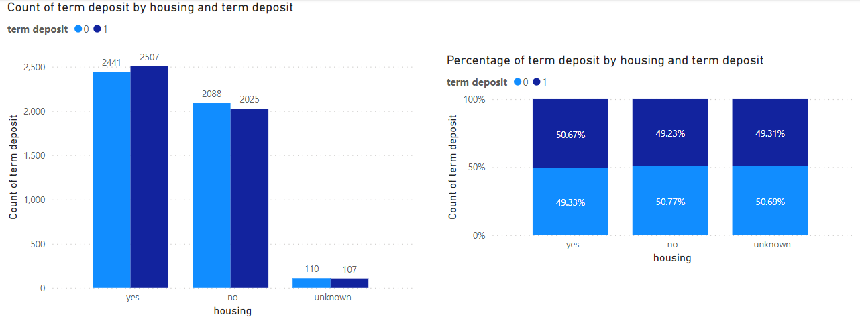
Data visualization

Slide 15
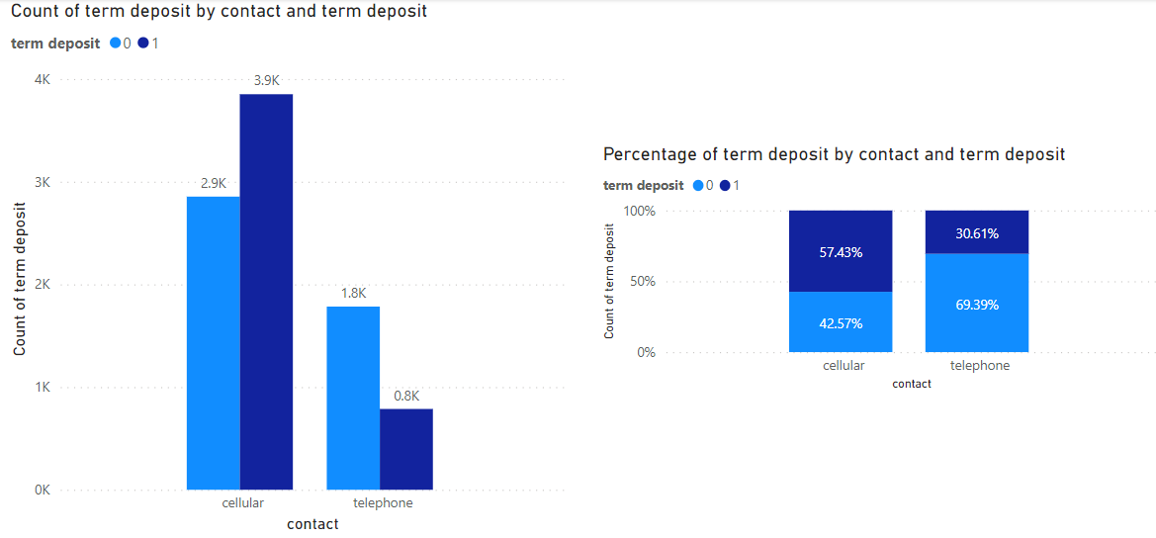
Data visualization

Slide 16
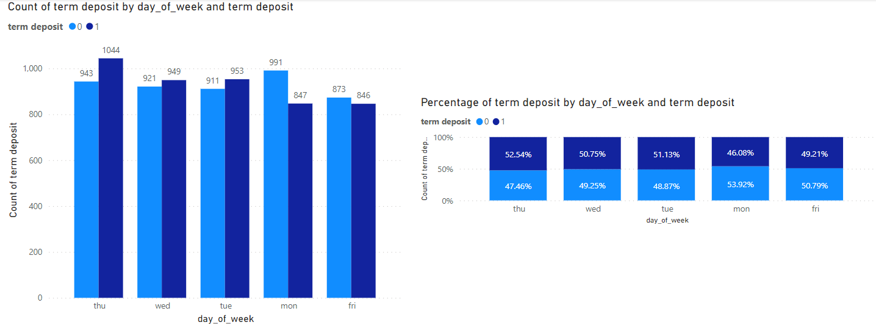
Data visualization

Slide 17
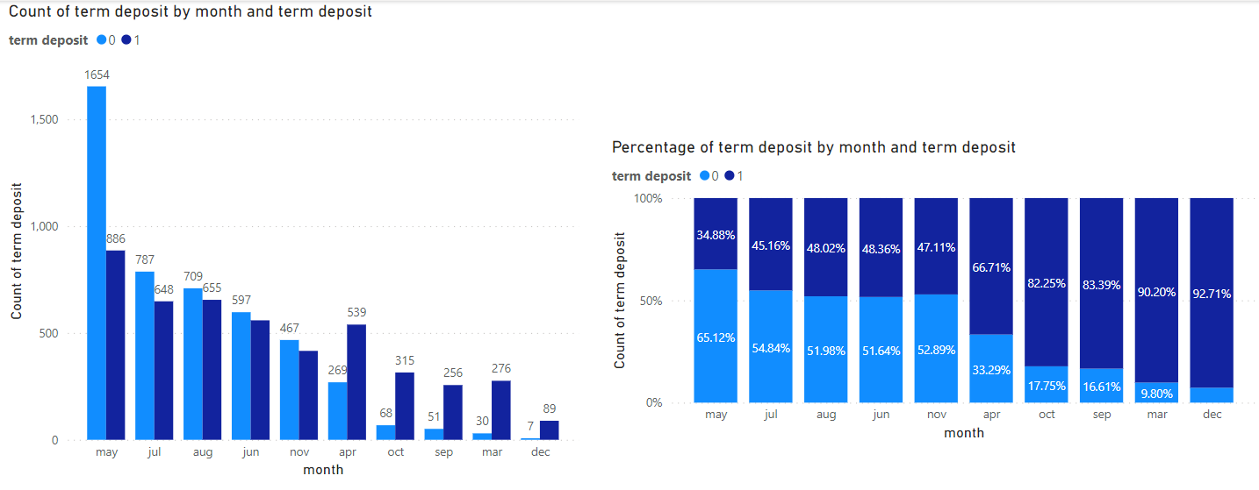
Data visualization

Slide 18
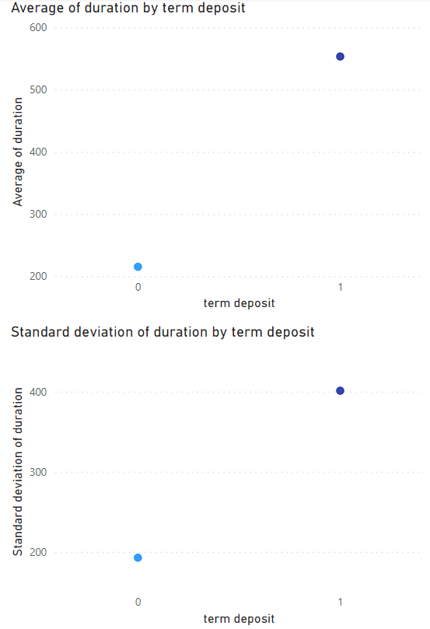
Data visualization

Slide 19
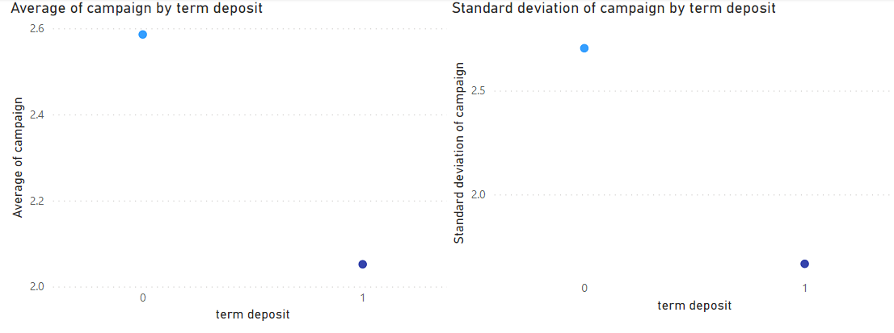
Data visualization

Slide 20
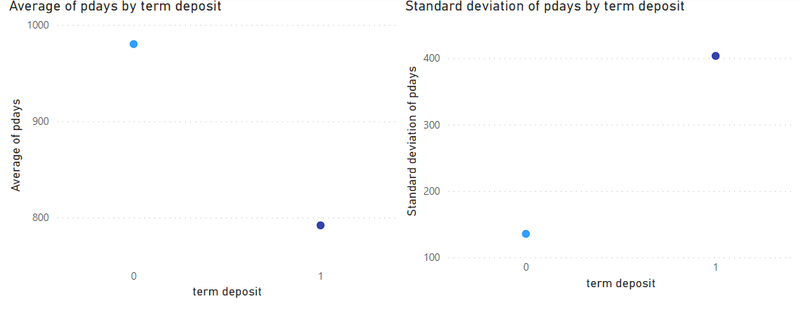
Data visualization

Slide 21
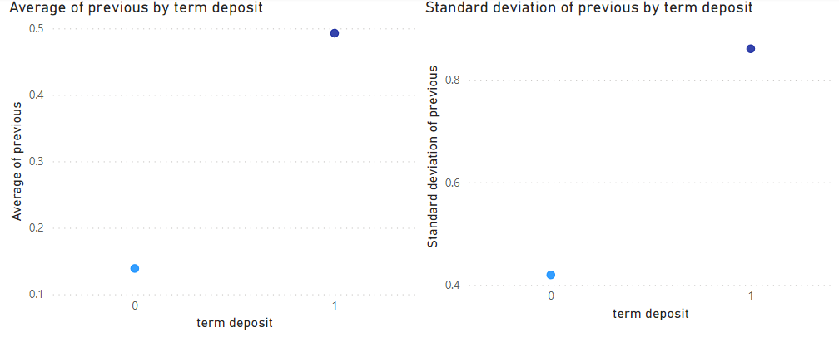
Data visualization

Slide 22
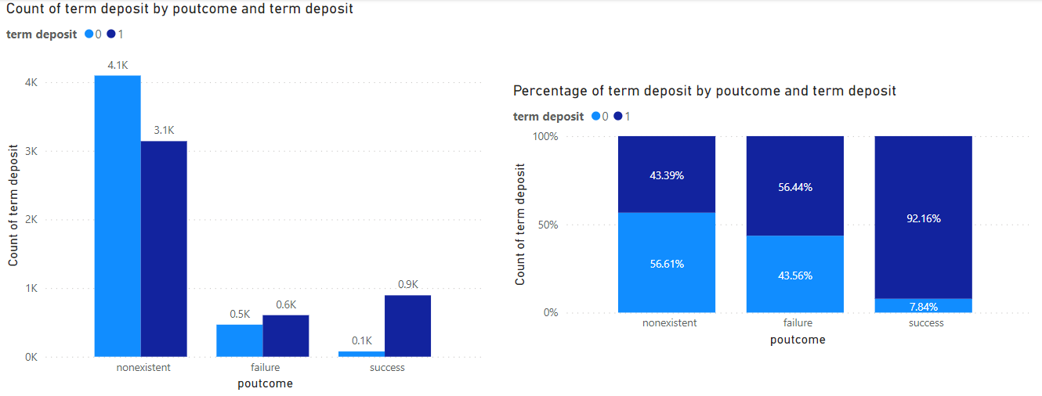
Data visualization

Slide 23
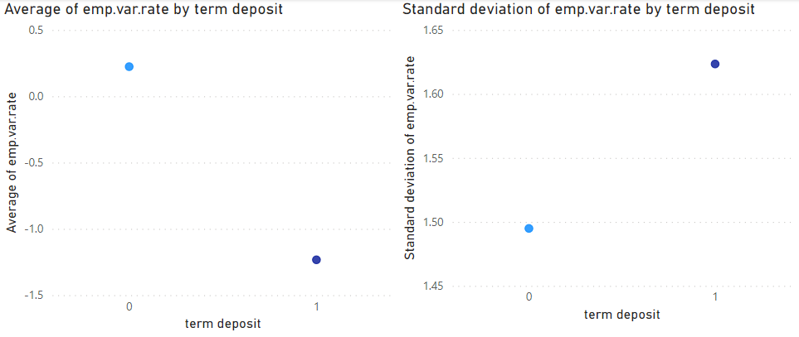
Data visualization

Slide 24
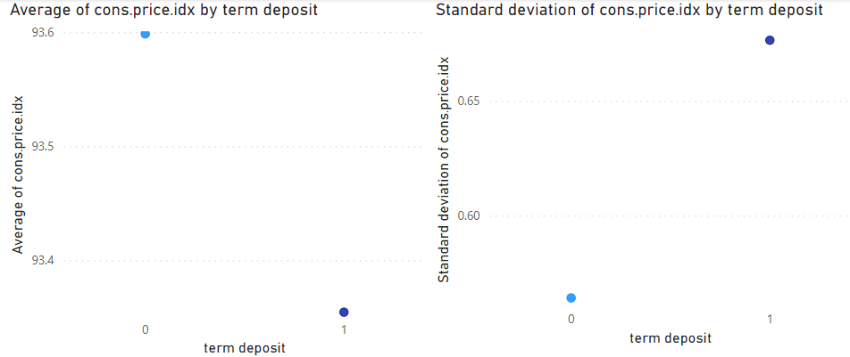
Data visualization

Slide 25
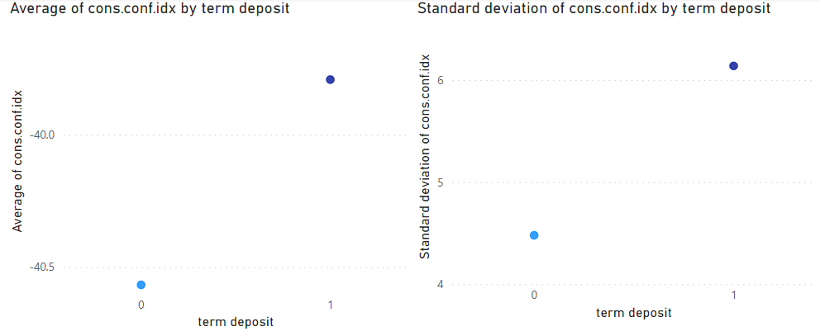
Data visualization

Slide 26
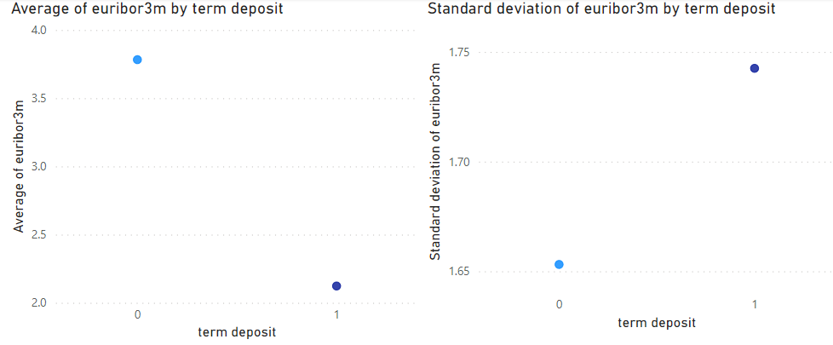
Data visualization

Slide 27
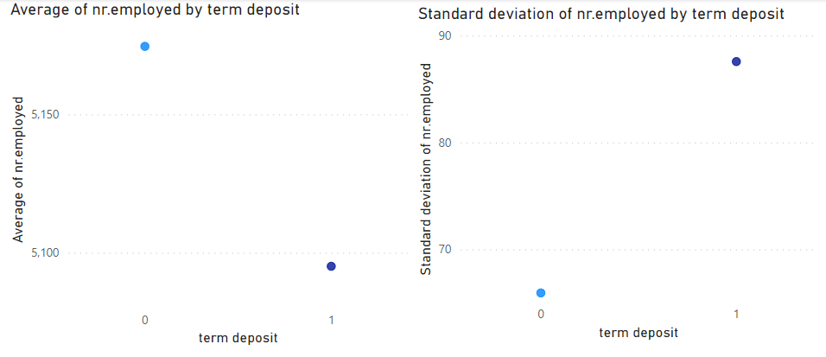
Data visualization

Slide 28
Recommendations
The recommendations are from various aspects based on the data visualization.
Age – People who age from 25 to 39 are the most likely group to use the term deposit product and also have the most potential to use it. 40 to 59 people should be given more incentives to use the term deposit.
Job – Blue-collar, entrepreneur and services workers should be encouraged more to use the term deposit product.
Marital – Divorced and married people are less likely to use the term deposit.
Education – The higher degree, the more chances to use the term deposit.
Loan – Whether has personal loans or not doesn’t necessarily affect the chance of using the term deposit.

Slide 29
Recommendations
Housing – Those people who have housing loans prefer to use the term deposit.
Contact – Sales should contact potential customers through cellular as much as possible.
Day of week – Sales should avoid contacting potential customers on Mondays or Fridays.
Duration – The more time spent on conversations, the more possibility for customers to use the term deposit
Campaign – ABC should lower the number of contacts through the campaign.
Pdays – ABC should contact potential customers as early as possible.
Previous – The greater number of contacts before the campaign, the more opportunity to use the term deposit.
Poutcome – ABC should pay attention to the outcome of every campaign in order to increase the customer loyalty.

Slide 30
Recommendations
Emp.var.rate – The more employment variation rate, the less opportunity to use the term deposit.
Cons.price.idx – The more consumer price index, the less opportunity to use the term deposit.
Euribor3m – The more euribor 3 month rate, the less opportunity to use the term deposit.
Cons.conf.idx – The more consumer confidence index, the mpre opportunity to use the term deposit.
Nr.employee – The greater number of employees, the less opportunity to use the term deposit.

Slide 31
Thank You

